Slide 1


PROCESS PERFORMANCE MODEL (PPM) GUIDELINES

Slide 2
PPM Lifecycle
Define PPM Objective
Define Lifecycle Scope
Program Thresholds
Lifecycle Selection - Standard Options
Setting Objective
Planning Phase
Establish baseline
Identify Distribution
Define Correlation
Establish Baseline
Develop a Model
Define Assumptions
Define Correlation
Link performance measures
Simulate the Model
What if analysis
Developing options and Evaluation
Modeling Phase
Sensitivity Chart Analysis
Improvement
Defect Prevention and Problem Prevention
Improvement in Project
Recalibration - Effort
Recalibration – Defect removed
Defect Injected – Hypothesis Testing
Recalibration – Defect curtailing
Recalibration
Execution Phase
Sub process Tracking
Entering Actuals
Baseline Analysis
Curtailing
In-process PPM
Post Execution Phase
Results and Lessons learnt

Slide 3
Program Thresholds
The threshold values for certainties of the targets are determined such that the alternatives beyond these threshold limits will only be considered for implementation.
Frequency of PPM re-calibration should be determined.
    If no alternative has certainty higher than the threshold, then the alternative with highest certainty would be taken and causal analysis would be done to improve the certainty.
    Generally it is done after the end of each phase, that is SRS, Design, etc.,

Slide 4
Life cycle Selection - Standard options
Determine the options that would be explored in the PPM for the particular project based on the standard options available at the Organization level and on the project needs.
The following are the sample standard options and the decisions on whether they would be explored.
S.no | Standard life cycle options | Remark
1 | Single Design (combined HLD & LLD) vs Separate HLD and LLD | This option is explored.
2 | With Test Automation vs Without Test Automation | This option is explored.
3 | With Static code analyzer vs Without Static code analyzer | Customer provided tool is used for the analysis hence this option is not explored

Slide 5
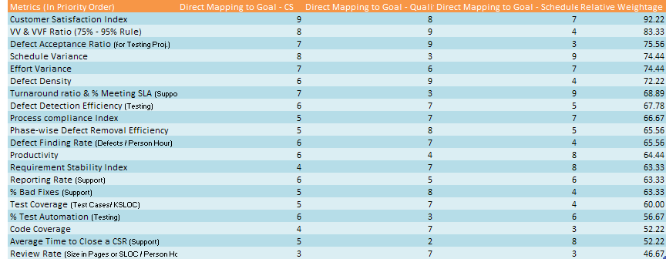
Define PPM
Identify the project end target based on the business goals and priorities.

Slide 6
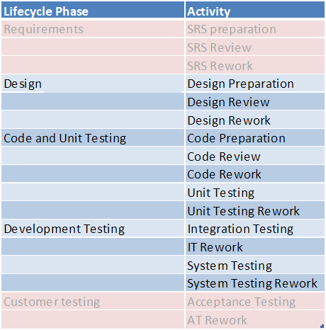
Define the Lifecycle Scope
Define the life cycle scope for which the PPM needs to be done. The activities which are not under our scope are not included.
Sample:
The Requirements phase and Customer Testing phase will not be considered in PPM, since it is done by customer.

Slide 7
Performance Baseline
Data collection, at the granular level at each phase, from the past projects with the preference to the closest projects
    Granularity:
      Effort: Preparation, Review Rework
      Defect: Defect injected, Defect removed
This baselining exercise is needed only if the baselines for the alternatives are not available.
Previous releases of the same project
Similar projects of the same program
Similar projects in the BU

Slide 8
Distribution, Regression and Correlation
The distribution fit of the data points for each performance measure (Eg: SRS preparation) is identified, and the same would be used in PPM.
Correlation among the performance measures are identified and the same would be used in PPM.
The Regression equation of the performance measure of various phases are derived.
    Distribution fit can be determined using the Batch fit tool in crystal ball.
    If the number of data points are less than 15 (Minimum requirement for Batch fit tool, then Anderson Darling test is used to determine its Normality. If it is not possible to identify the distribution, then the distribution is assumed to follow Normal distribution and the same is used in PPM.

Slide 9
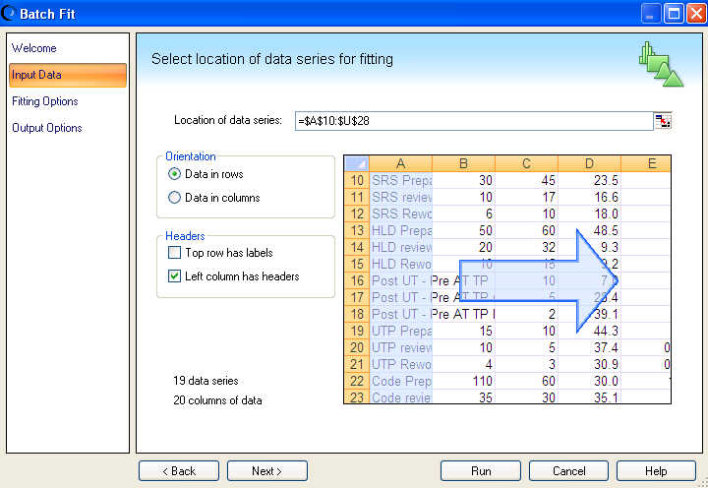
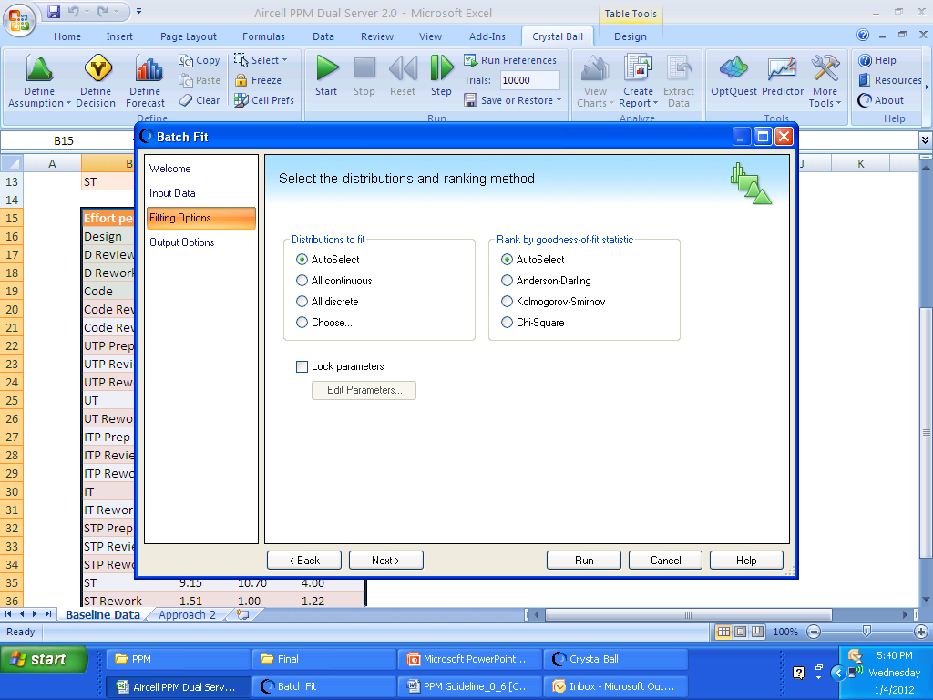
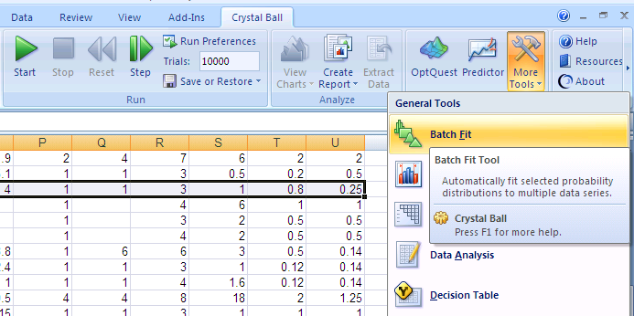
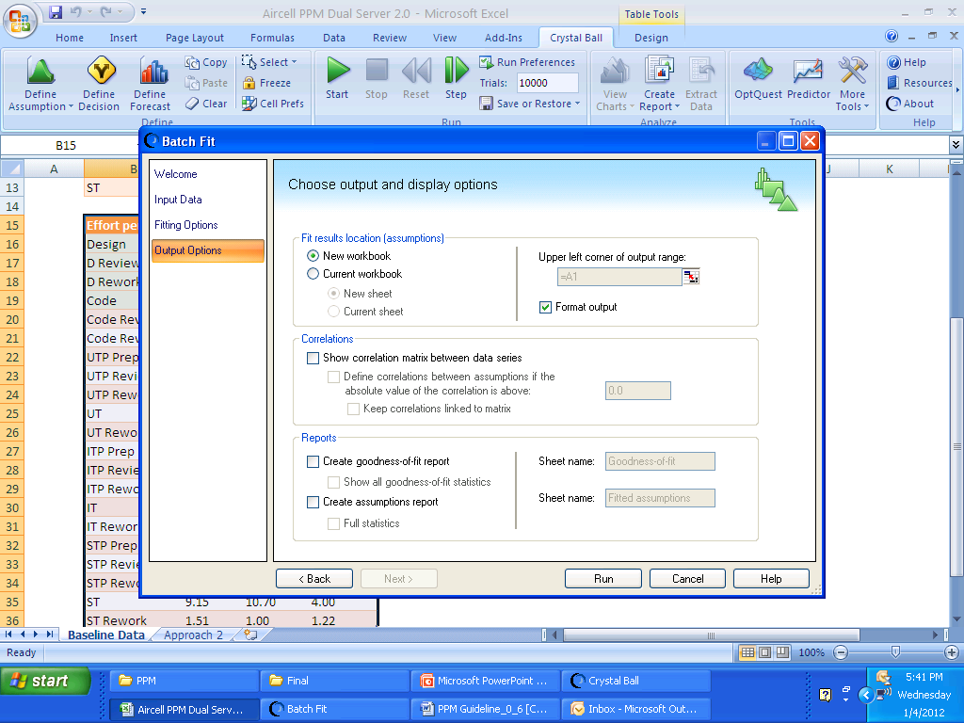
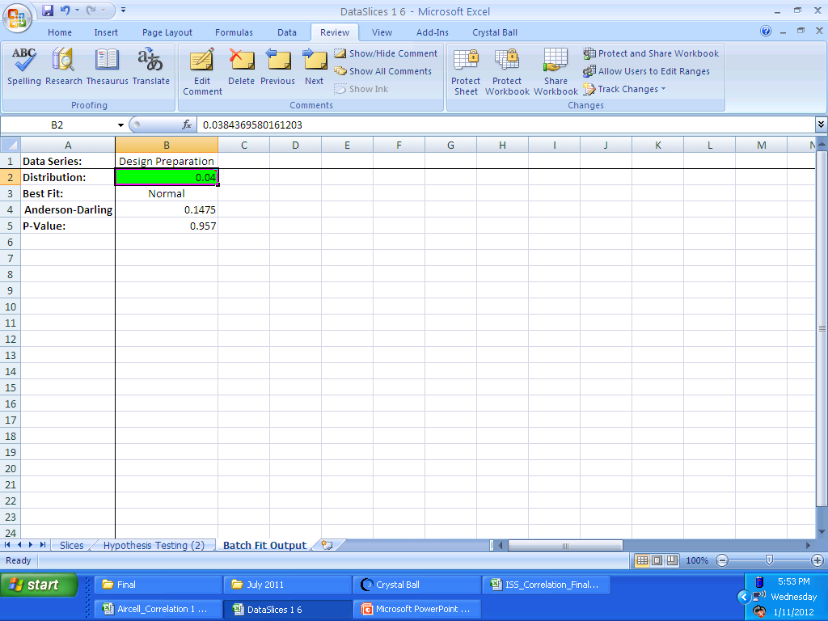
Distribution
Distribution followed by the data points. The same will be used in PPM while defining the parameter.
Select the Batch fit tool from the More tools menu.

Slide 10
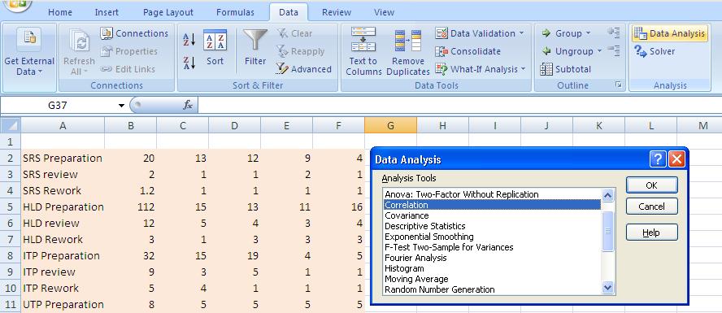
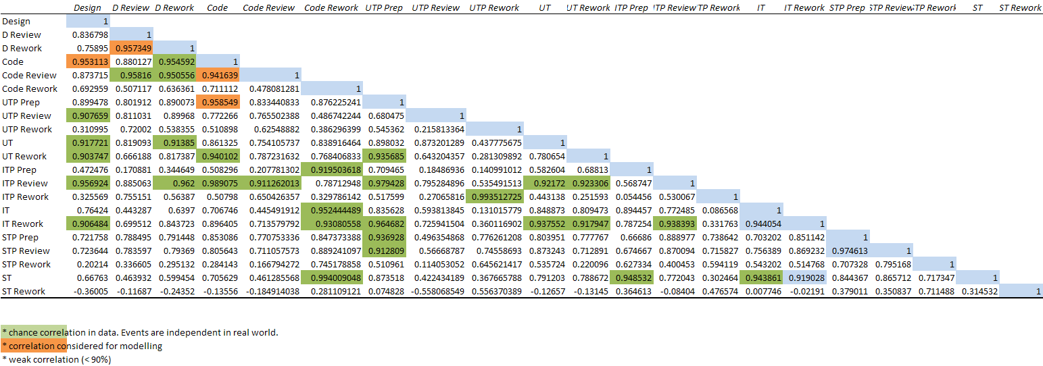
Correlation
  The correlation among the various performance measures are identified using the Correlogram.
Click on the Data Analysis to get the correlation.
Click on the Correlation menu item to get the correlation input screen.
Correlogram with the correlation among various parameters. Identify the applicable correlation values which are high and practically possible. The same will be used in the PPM while defining the parameters.

Slide 11
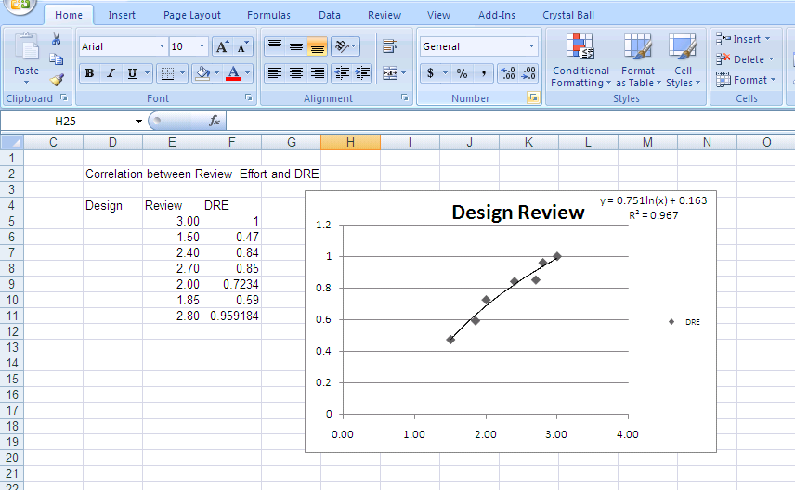
Regression
The Regression equation can be obtained from the scatter chart, along with the co-efficient of determination.

Slide 12
Develop a Model
The Simulation Model is developed based on the Baseline data for the lifecycle scope. Various models are developed for each of the alternatives that are considered from the standard alternatives.
    The assumptions of each step of performance measure are defined for the Mean, Standard deviation and distribution of the parameter based on the inputs from the Baseline report.
    The performance measures of each step are linked with the other to arrive at the overall performance measure value.
    The correlations among various parameters are also defined in their assumptions.
    The targets are defined as forecast with their limits defined as per the goals.
The correlation input is interrelated such that the correlation between two parameters need not be entered for both parameters. Input in one parameter will automatically populate the same correlation in the corresponding correlated parameter’s input.

Slide 13
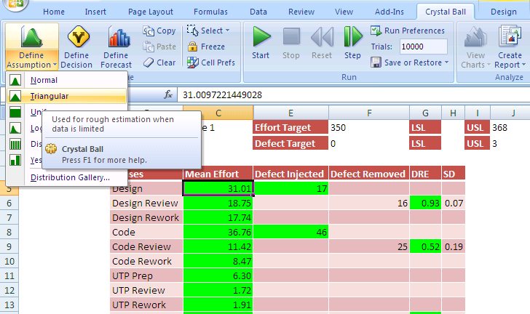
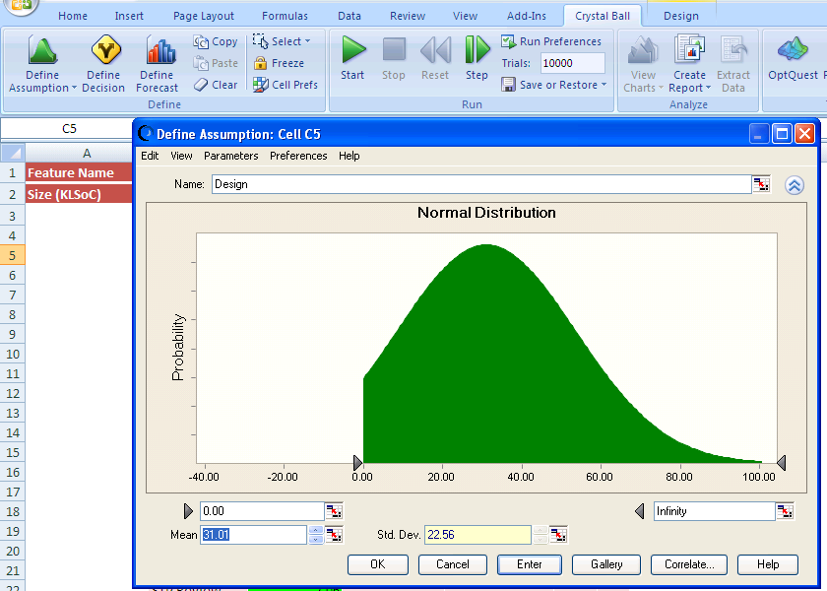
Defining Assumptions
Select the appropriate distribution from the assumptions tool for the particular parameter.
Enter the Mean, SD and the limits for the parameter.
Click on this button to input the correlation of the parameter with others.

Slide 14
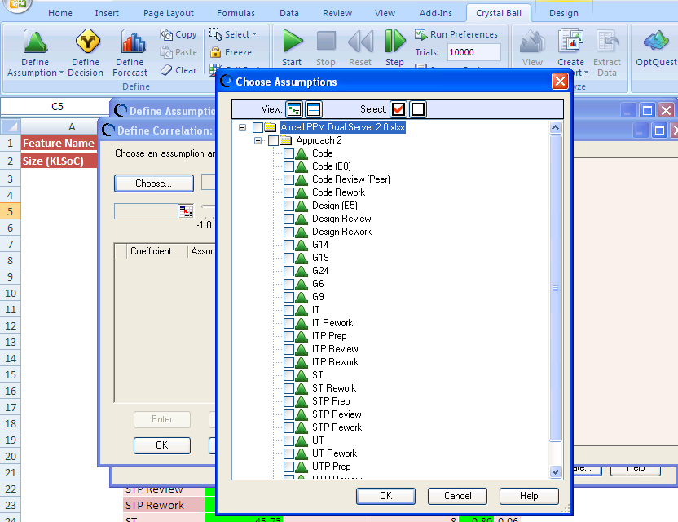
Correlation in Assumption
Click on this button to select the parameter with which the correlation is to be defined.
Select on the parameter(s) with which correlation needs to be defined.

Slide 15
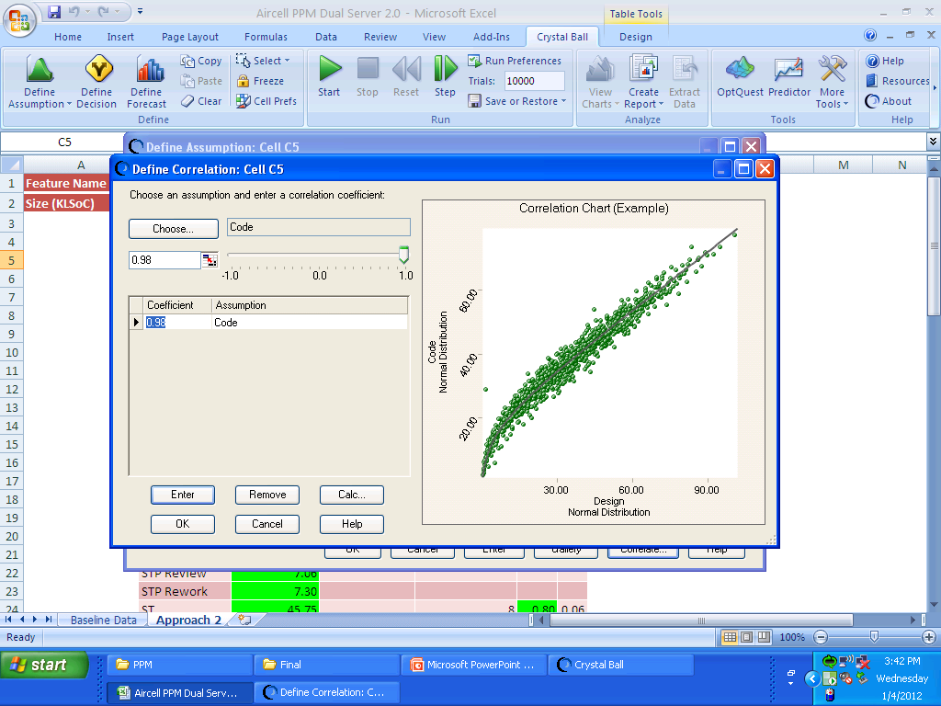
Correlation in Assumption - Contd
Enter the correlation value between the two parameters and click Enter. Use the same procedure to define another correlation. If all the correlations are defined, press OK to move back to Assumptions.

Slide 16
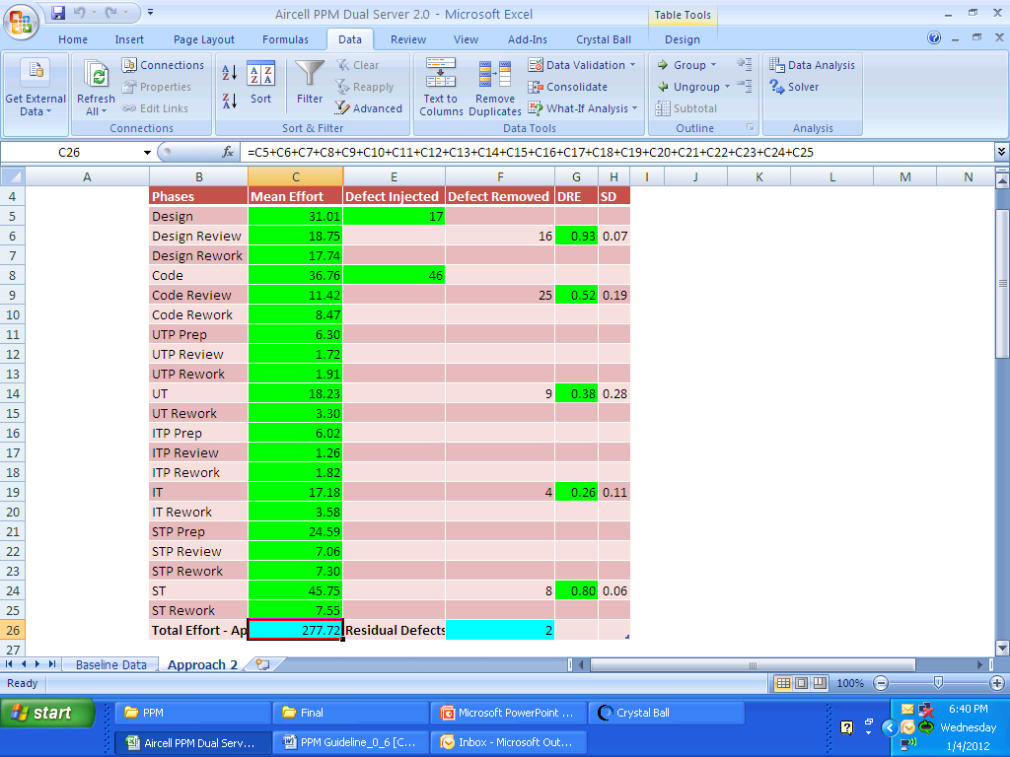
Link Performance Measures
Enter the formula to arrive at the total performance measure value, so that the value in the cell defines the performance measure.

Slide 17
Simulating the Model
The model is simulated (Monte Carlo Simulation) using the Crystal ball for all the alternatives.
The certainties of achieving the targets and the sensitive phase in the process, for all the alternatives, are obtained as a result of simulation.
Based on the certainty, the best alternative is chosen for implementation .
For the selected alternative, the sensitivity chart from the simulation is used for determining the sensitive phase in the process.
    For identification of the sensitive phase, the sensitivity chart, from the simulation run without considering the correlation, should be used.
    Higher number of trials (10000) would give a more even distribution.

Slide 18
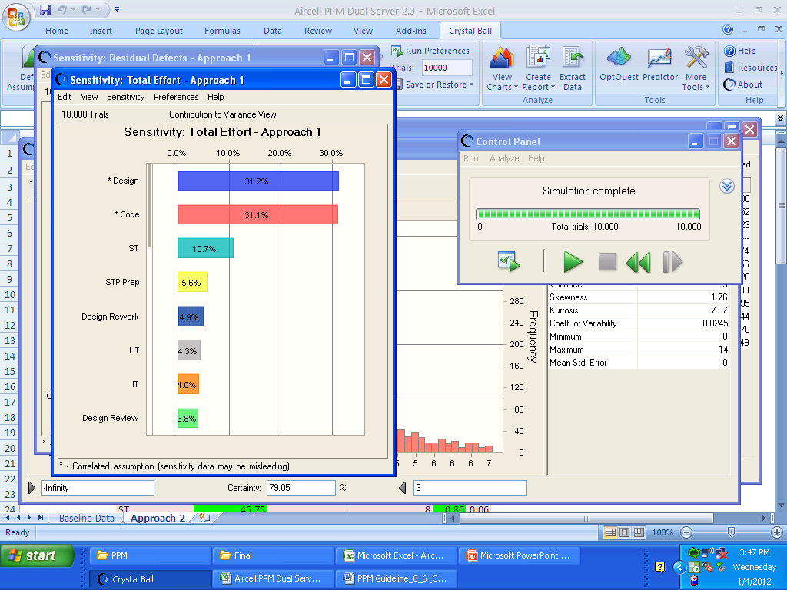
Simulation Results

Slide 19
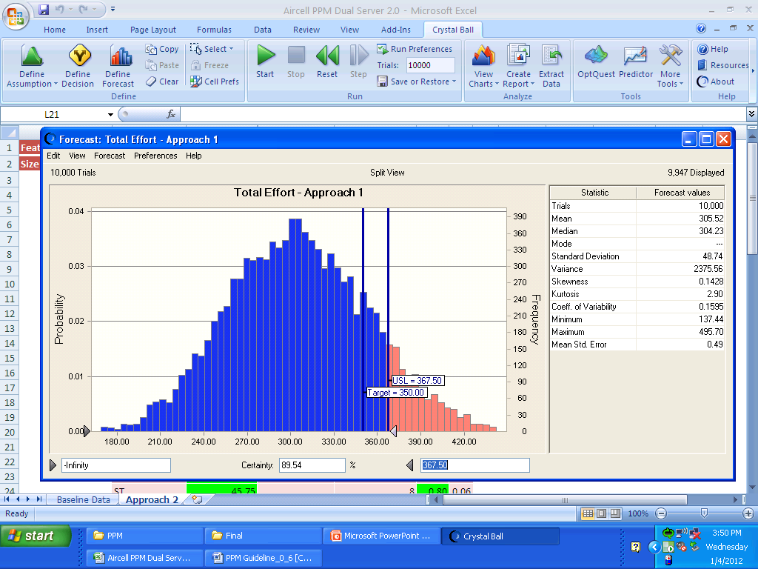
Certainty Chart
This value defines the certainty level of the particular performance measure meeting the defined target.
Limits for the performance measure target.

Slide 20


What if Analysis
Select the best alternative based on the certainties of achieving the targeted performance measures.
The selected alternative should have the certainties higher than the threshold limit set for the performance measures.
Further analysis can be done to improve the certainty of the selected alternative.
Sample

Slide 21
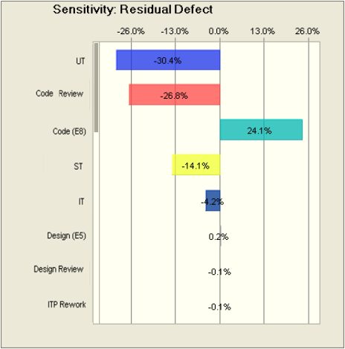
Simulate each step performance measure (Option 2.0)
The sensitivity chart lists down the sensitive phases affecting the end goal in the descending order (w. r. to magnitude of impact). The sensitivity is expressed in terms of percentage on both sides of the zero line.
The sensitivity chart explains the variance of the parameters affecting the end target. Higher sensitive parameter implies that the mean or standard deviation of the parameter needs to be controlled using the control charts, as required.
If the sensitivity of parameters are not significantly different, all the parameters need to be controlled.
The parameters covered in the area of the dark line should be controlled.
    The +ve sign implies the direct proportionality of the particular parameter to the targeted end goal. And –ve sign implies the inverse proportionality.
    Common Facts misunderstood: The sensitivity charts does not reflect the impact of the mean or SD of the parameters on the end goal, but the variance of the parameters on the end goal
If the sensitivity of parameters are not significantly different, all the parameters need to be controlled.

Slide 22

Improvement
The Defect prevention and Problem prevention plan is devised and it is incorporated into the model and it is simulated again.
The steps to be followed in the process are finalized including the results of the Defect prevention, Problem Prevention and Causal Analysis. Based on the Causal analysis and DP, determine the areas that need to be tracked closely.
The possible value of “defects detected” from the Worst case Scenario of DP plan is substituted in the corresponding “Defect removed” parameter.
The Regression equations of the corresponding parameters are substituted to determine the apportioned values of the related parameters, which change due to the DP and Problem prevention
    Example: The regression equation of the Code defect detected to the rework in the Code, UT and Post UT – Pre AT phases are considered.

Slide 23
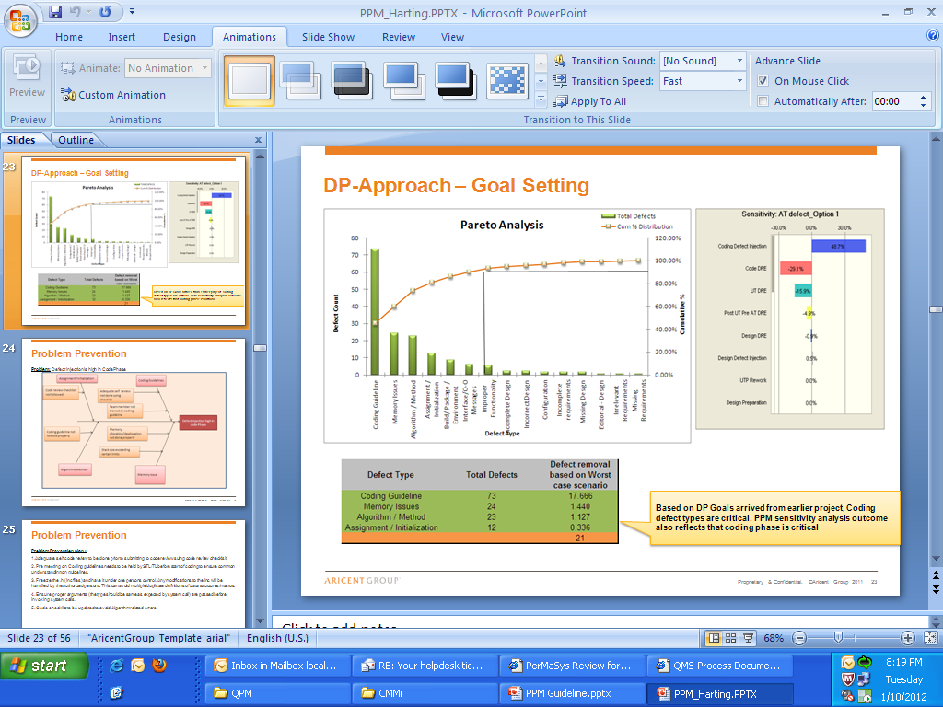
Defect Prevention and Problem Prevention

Slide 24
Regression Equation
The Worst case defect value from DP plan is substituted for the corresponding parameter.
The defects removed and defect injected values are re-calculated based on the regression equation with the changed parameter.
The effort values are also changed based on the regression equation.
    During the substitution of new values in the assumption of the corresponding parameter, only the mean of the parameter is changed. The SD and correlation are intact.
    When DP is considered, the defects detected and bug fixing/ rework of the later phases will reduce.

Slide 25
Calculation of New DRE
For models using DRE as the variable for defect removal, the corresponding Defect removal values obtained from the regression equation are used to calculate the new DRE.
For example, the old DRE =0.55, the defect removed = 75 and the new defect removed value from regression equation with DP value = 100, then new DRE will be calculated as follows.
New DRE = {Old DRE * (New Defect removed/ Old defect removed)}
  = {0.55*(100/75)}
  = 0.733
    While new DRE is substituted, the relationship (Formulae) among the defect injected, DRE and defect removed parameters should not be changed. The new defect removed will automatically be updated with the effect of new DRE.

Slide 26
Recalibration
The selected alternative, with the finalized process steps, is implemented in the project.
After completion of every phase, the actuals of the corresponding phase are fed into the model.
This is done by redefining the assumption of the performance of the step with the replacement of mean with the actual value and standard deviation with infinitesimal value.
The Regression equations are used to calculate the new values for the parameters as done during the process improvement.
The simulation result is analyzed and if the certainty of the model is below the threshold level, corrective and preventive actions are taken. The same procedure is followed for recalibration after each phase.
While entering the actual of a parameter, substitute Mean with actual value and SD with an infinitesimal value since the Model will not allow Zero as an input.

Slide 27
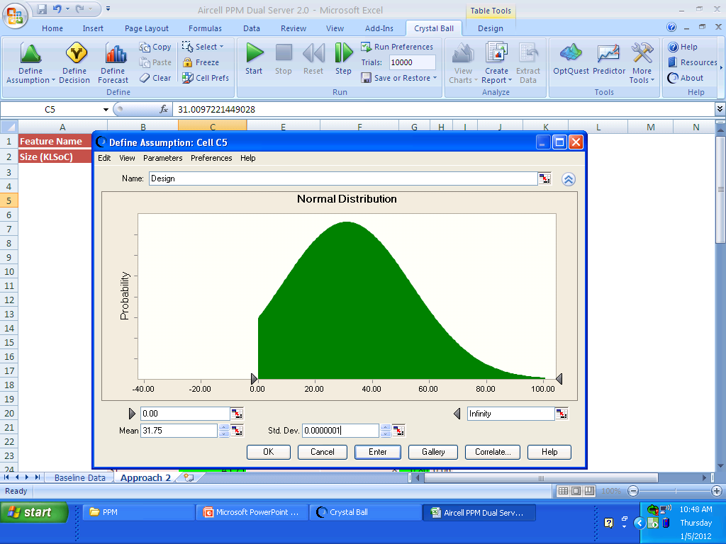
Recalibration - Effort
For instance, Recalibration is to be done after the Design phase, the actual needs to be entered for Effort and Defect removed.
For effort, enter the actual value in the Mean and an infinitesimal value as SD. The other values are not changed.

Slide 28
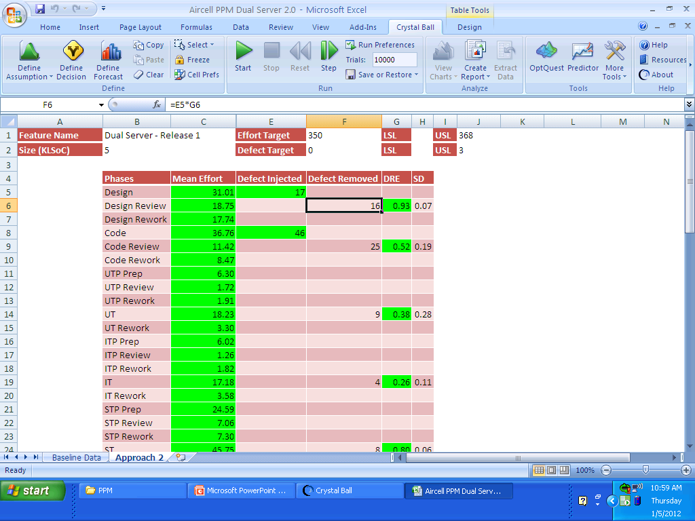
Recalibration - Defect Removed
The defects detected in the design phase are entered in the defect removed cell. The formula written w. r. to DRE or Defect Density will become void for the particular cell.

Slide 29
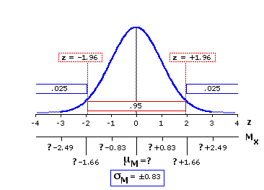
Defect Injected – Hypothesis testing
The lower limit of the Defect injected needs to be curtailed based on the defects removed. The limit is set such that the total number of defects injected should be greater than or equal to the total defects removed in the corresponding phase(s).
Hypothesis Testing is done to verify that the defect removed value is part of the “Defect injected” parameter’s distribution’s 95%.
For instance, if the Defect injection parameter is normally distributed with a mean of 45 defects with 3.5 as SD and the defect removed from that phase is observed to be 67 which is not a really possible value from that distribution. To determine these kind of cases, the Hypothesis testing is done
Desired Area: Hypothesis Testing is done to verify whether the Defect removed lies within this 95% area

Slide 30
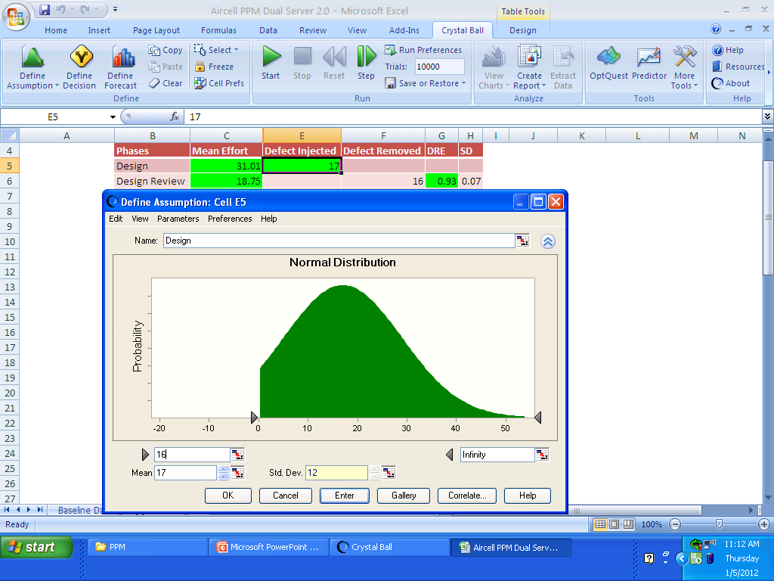
Recalibration – Defect Curtailing
The actual defect removed is entered as the lower limit for the defect injected parameter of the corresponding phase considering that the defect injected should be grater than or equal to the defect removed.

Slide 31
Sub process Tracking
Sub process is used for the phase(s) that need to be tracked closely, based on the sensitivity chart inference. There can be more than one sub process based on the sensitivity chart.
The frequency of analyzing the sub process and using the same in the PPM needs to be determined.
The Baseline is set and the actual values are tracked in the sub process sheet.

Slide 32
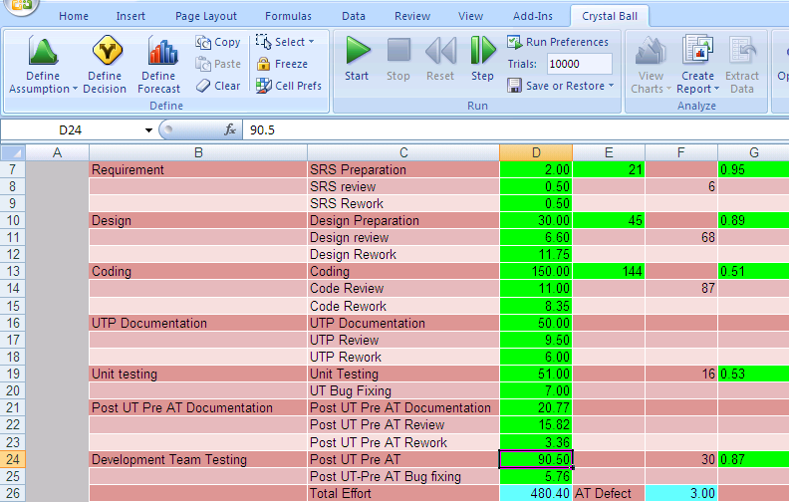
Model Before Sub process Curtailing
Effort based on the initial baseline estimate of the parameter selected for sub process.

Slide 33
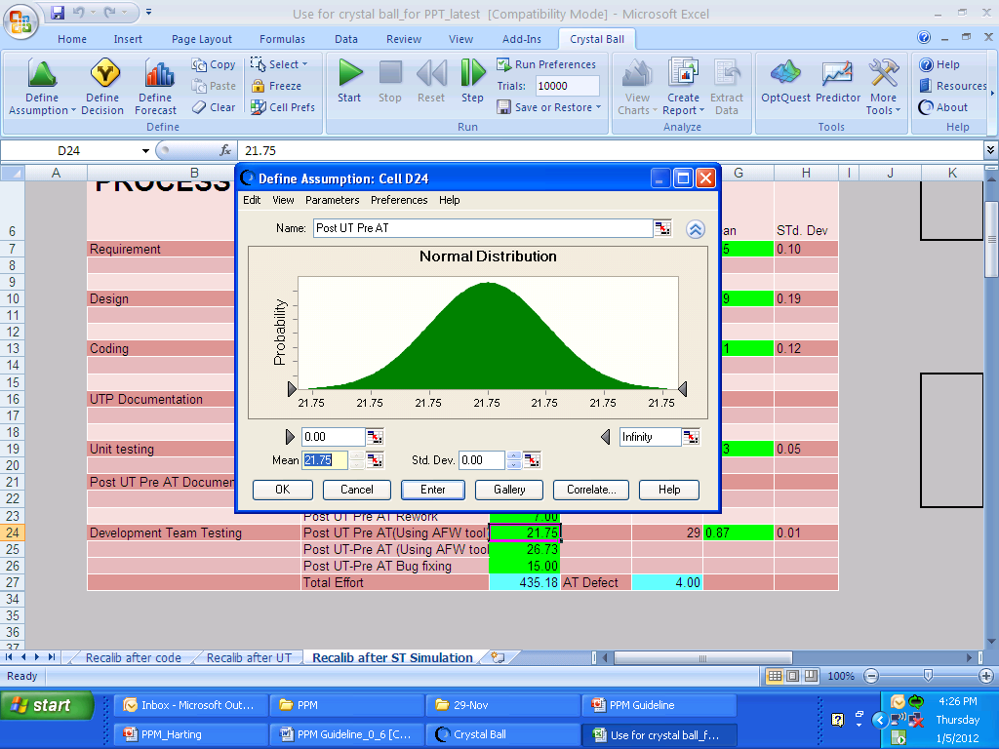
Sub process – Entering Actual Effort
Actual effort in the time period.

Slide 34
Sub process - Analysis
The hypothesis testing is done to test whether there is a significant change in the values between the time periods.
If there is significant difference, the mean and standard deviation of the performance measure is changed and set as the new baseline. The model is re-simulated with the new baseline for the process step and corrective and preventive actions are taken if needed.
If there is no significant difference, the old baseline is retained.
The similar procedure is followed for the remaining time periods.

Slide 35

Sub process Curtailing
Mean and SD arrived for the remaining activities in the sub process phase, based on the new baseline.
Effort estimate based on the new baseline of the parameter selected for sub process.

Slide 36
Result (Sub process – Analysis)
The results of each alternative and the process improvements and recalibration after each phase are recorded in the controlled area, once completed.
The final result of the project is recorded. The model is justified with the actual values of the targeted performance measures.
The lessons learnt during the project implementation, with respect to quantitative project management, are recorded. The lessons learnt are used as a reference for the next projects.

